Slide 1
Volag
Weather Delay Analysis
Cory Sabol
Josh Moore
Alex Hahn
Travis Cox

Slide 2
Goals
Identify causes of flight delays
Focus on weather observations on the day of a particular delayed flight
Find other correlations in data
Predict flight delays
Whether or not a flight will be delayed
How long a flight will be delayed

Slide 3
Progress
Linked weather stations to airports
Merged weather data with flight data
Visualized data
Performed initial correlation analysis
Created correlation heatmap, correlation matrix, and analyzed top correlation figures
Started training decision tree model

Slide 4
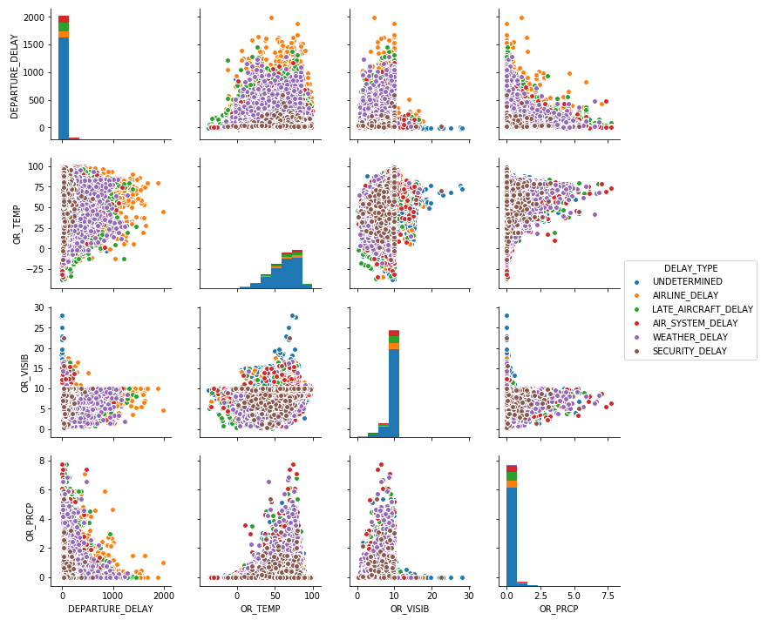
Findings
Almost no apparent correlation between individual weather features and delay.
Notes:
Get better graphics

Slide 5
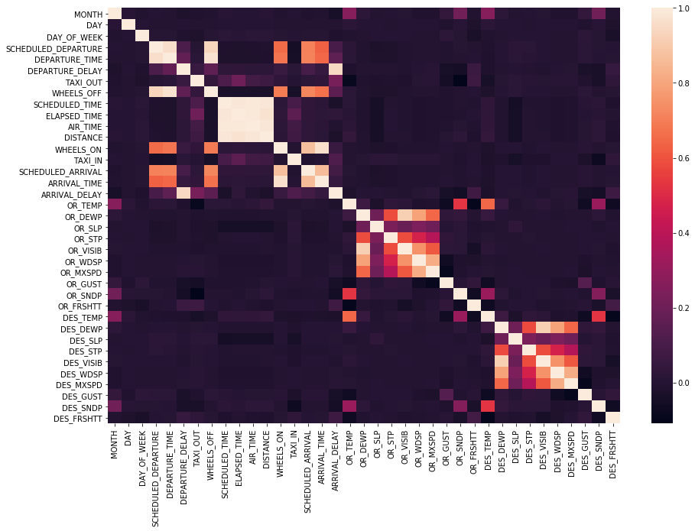
Correlation heatmap of flight features vs. weather features

Slide 6
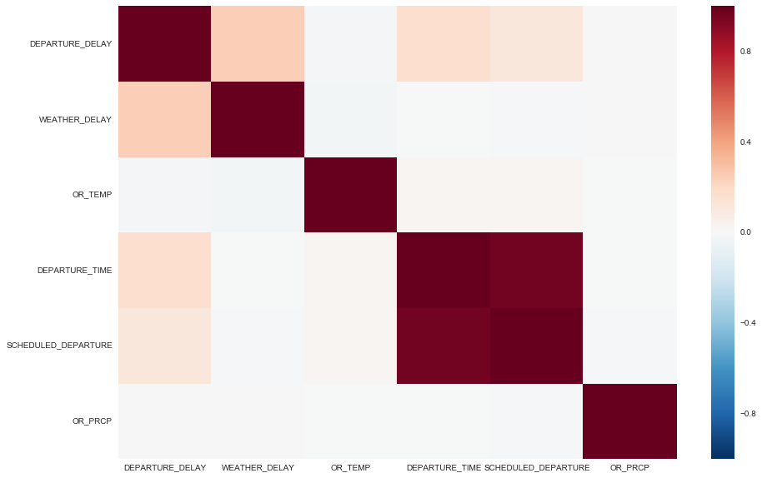
Another correlation heatmap - no correlation between delay and temperature or precipitation

Slide 7
Challenges
Weather data is daily instead of more granular
Flight data doesn’t show which airport was the cause of the delay
Was the delay caused at the origin or the destination
Single features may not capture the complexity of weather effects
We’re able to use temperature, wind speed, dew point, air pressure, visibility, gust, etc.

Slide 8
Going Forward
Continue to search for correlations
Train models to find features, or combinations of features, that can predict flight delays
Possibly find better weather data (time intensive)

Slide 9
Questions

